Slide 1
Module 7
UiPath Project Planning and ReFramework

Slide 2
Learning Objective
UiPath Project Layout
Advance Exception Handling
State Machine
RE-Framework

Slide 3
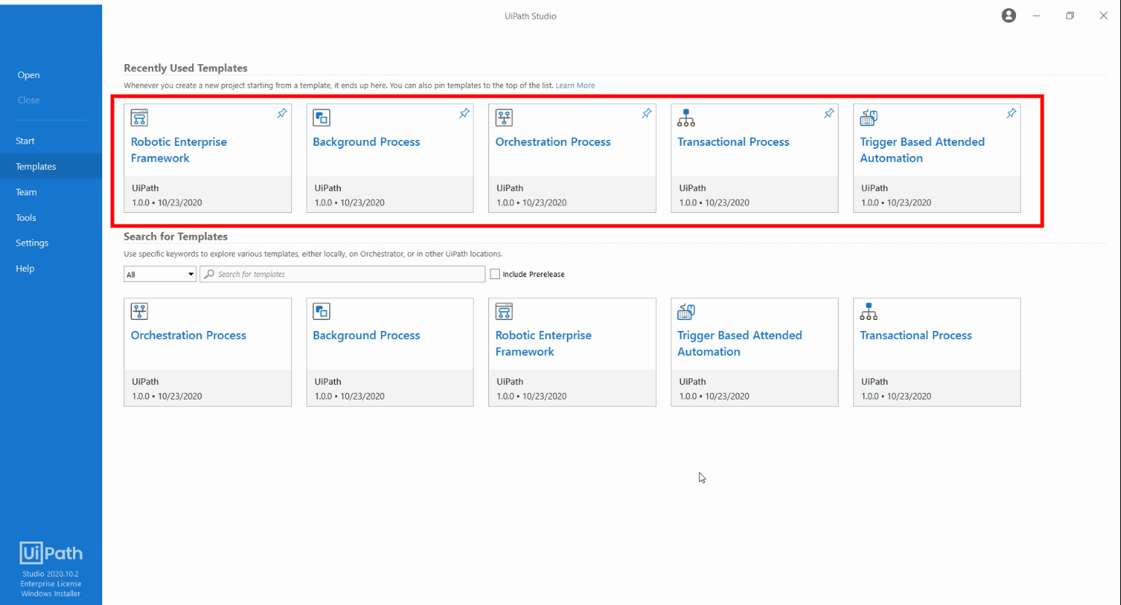
Project Layout and Templates
Orchestration Process
Long-running workflows are master projects which support service orchestration, human intervention, and long-running transactions in unattended environments
Background Process
The Background Process is a template for creating processes that can run in parallel on the same Robot, together with one foreground process. For this reason, background processes must not contain activities that require user interaction.
Robotic Enterprise Framework [Most Important!]
Robotic Enterprise Framework is a project template based on State Machines. It is created to fit all of the best practices regarding logging, exception handling, application initialization, and others, being ready to tackle a complex business scenario.
Transactional Process[Start With This…]
The Transactional Process is a project template based on a Flowchart, optimized for basic automation processes.
Trigger Based Attended Automation [For Attended Robot only…]
Trigger Based Attended Automation is a project template based on a Sequence, that is tailored to monitor certain triggers such as a mouse or keyboard event and deploy an automation.
This sequence contains a Trigger Scope activity named Monitor Agent Action that contains triggers for clicks, keystrokes, and hotkeys, a Get Source Element activity to retrieve UiElement objects and a container for adding event handling logic.

Slide 4
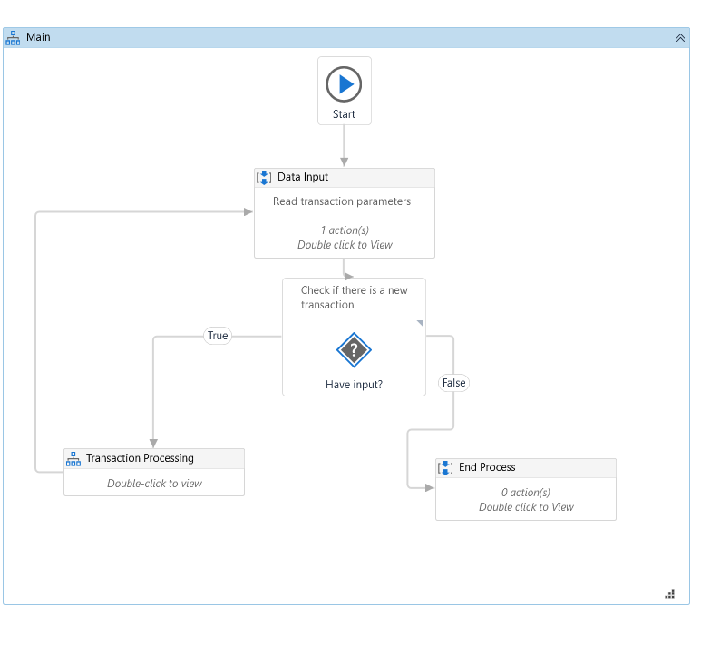
Transactional Process
The Transactional Process is a project template based on a Flowchart, optimized for basic automation processes.
1. Data Input Sequence – Initiate and read your transaction data here. 2. Flow Decision- Check if there is any data to process ?
3. Transaction Processing- Perform actual steps here.
4. End Process – Close and Free Resources if any
Note-You can modify this as per your need to include retry methods and exception handling ?

Slide 5
Demo Transactional Process
Trainer will explain and guide to create project from Transactional process and help you to modify as per need.

Slide 6
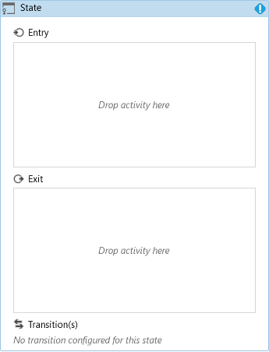
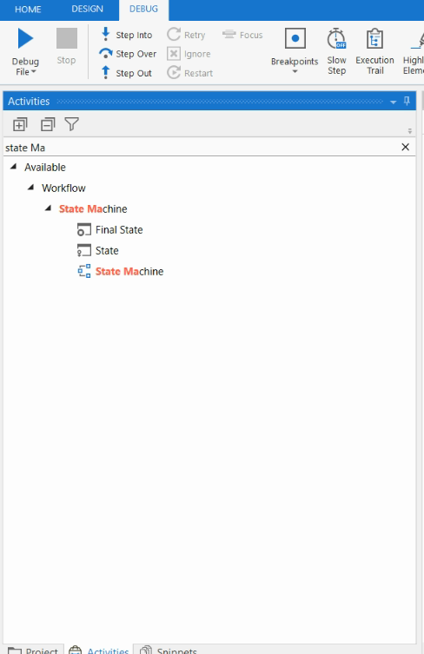
State Machine
A State Machine uses a finite number of sets in its execution. It can go into a state when it is triggered by an activity; it exits that state when another activity is triggered. Another important aspect of State Machines is transactions.
They enable you to add conditions based on which transactions jump from one state to another. These are represented by arrows or branches between states.
There are two activities specific to State Machines. They are State and Final State, and they are shown in the screenshot.
The State activity consists of three section Entry, Exit, and Transitions, while the FinalState only contains Entry

Slide 7
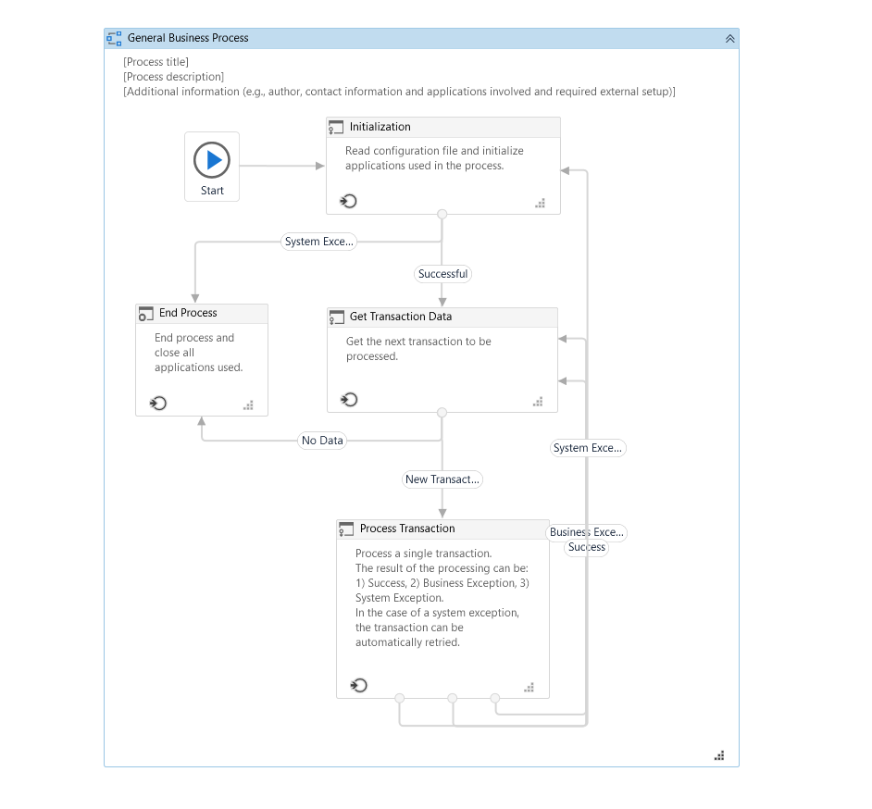
UiPath Reframework/Robotic Enterprise Framework
What is ReFramework?
Robotic Enterprise Framework or Re-Framework is a template that is used to create automation workflows in a modular approach for large scale deployments.
At a high level, it provides an excellent Exception Handling mechanism, retrying a failed transaction, application recovery and the ability to stop the process where continuing to run the Bot does more harm than good. Reframework enables you to put the external settings in a Config.xlsx file and Orchestrator Assets instead of hard coding settings like a Shared Network Path location or Credentials within the script.
UiPath ReFramework Architecture
The ReFramework uses the state machine diagram and has the following 4 states:
Init State
Get Transaction Data State
Process Transaction State
End Process State
The key advantages to leveraging the ReFramework are highlighted below:
Logging: Exceptional logging mechanism to monitor the process and error handling.
Scalability: Ability to retry a failed transaction multiple times and send exception notifications.
Consistency: Variables, assets and Orchestrator Settings are consistent across ReFramework and will be easy to understand and the code standards will allow for a more painless handover to a different developer.
Reusability: Works for any type of processes and business logic code is separated from other aspects of Reframework like exception handling which enables it to be used across multiple processes.
Error screenshots: ReFramework has the functionality to take a screenshot of the screen at the point where it failed, which useful in unattended automations and overall troubleshooting.

Slide 8
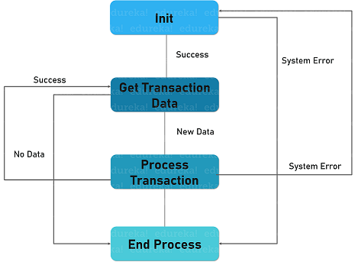
How Robotic Enterprise Framework Works
INITIALIZE PROCESS
InitiAllSettings - Load config data from file and from assets
InitiAllApplications - Login to applications as per Config("OpenApps") field
GetAppCredentials - From Orchestrator assets or local Credential Manager [Not Available in Latest Release ]
If failing, retry a few times as per Config("ProcessRetries")
GET TRANSACTION DATA
./Framework/GetTransactionData - Fetches from Orchestrator queue as per Config("TransactionQueue")
./GetTransactionData - Sample for working with Excel input files
PROCESS TRANSACTION
Try ProcessTransaction
If application exceptions happen
SaveErrorScreen - In Config("ErrorsFolder") with the exception message
Going to re/INITIALIZE
SetTransactionStatus - As Success, Failed or Rejected with reason
./Framework/SetTransactionStatus - Updates the Orchestrator queue item
END PROCESS
CloseAllApplications -

Slide 9
INITIALIZE PROCESS
This is the initial state which is used to -
Read and Store the config data in the dictionary(in_Config)
Close all the unnecessary applications and open the required one.
You can configure any additional step you need to initialize all you application.
For example, if in the Process we need to upload an attachment in SAP, we first require the Bot to fetch the credentials from Orchestrator, open the SAP application and then login to SAP using the credentials.
The best part of UiPath ReFramework is that it is built in such a way that you can initialize all the applications necessary here in the Init state and if the conditions you have built are met, the Bot will then move forward with processing the transaction.
If there is an error while initializing the applications or the credentials provided are invalid, an exception notification will be sent from within Init State and end the process.
Config Files
Assets
Folder Structure
Any other Config or Assists
INIT
Read Config
Close Open application
Initialize any settings and Folder Structures etc.
Open All Required Application
Get Transaction Data state

Slide 10
GET TRANSACTION DATA
Get Transaction- It is the data retrieval state, which is used to get the transaction from queue, data table, folder, database and other sources.
Yes, once the Bot successfully initialized all the applications it requires for a process. Hence, it looks for any transaction items in the Orchestrator Queue to process.
ReFramework prebuilt functionality looks for a Stop Request and will stop the process even though there are items still in the Queue to process.
This becomes helpful in situations where you notice the Bot is not doing what it is expected to do and want to stop the process before it works on any other transaction items.
In this state, you have two possibilities. If a new process is retrieved then it goes to the next state i.e. the Process Transaction state, else if all the transactions are processed then it goes to the End Process state.
in_Config [Dictionary for all configs]
Open Applications
GET TRANSACTION DATA
Read Queues or other source to Get Data for Processing
Transaction items including Transaction ID, Transaction Data
Process Transaction State

Slide 11
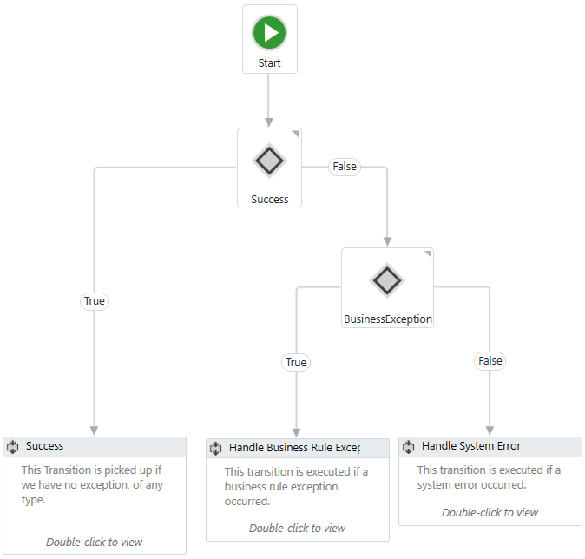
PROCESS TRANSACTION
Process Transaction- In this state, the transactions are processed that are fetched from the previous state. And if there is no record to process, the robot automatically moves to the end process state.
Going back to our example of attaching a document in SAP, the Bot has now initialized the SAP Application, got the Transaction Data from the Queue and the Bot should now upload the attachment to SAP. So, here in Process State, all the activities to attach the document are invoked.
For example, a workflow to check if the document exists or not on the Shared Path, a workflow with activities like clicking on appropriate GUI Elements for the Bot to navigate through SAP, type in the file path and look for the confirmation that the document was successfully attached.
ReFramework has prebuilt SetTransactionStatus workflow that can be used to set the Transaction Status of an item to either Success, Business Exception or Application Exception
For example, if the document the Bot is looking for is not in shared path, the Bot can set the status as business exception and notify the business team about the missing document.
An Application Exception is when the Bot encountered an unknown exception, either due to the SAP application crashing or the Bot could not look for certain elements it is supposed to.
Application Exceptions can be retried multiple times and the Bot will retry the same transaction item to see if it has a successful status on its second retry

Slide 12
END PROCESS
End Transaction- This is the final state of ReFramework that ends the robot successfully and closes all the applications.
After the Bot has finished processing all the transaction items from the Queue, it will log out applications, irrespective of if it is a failed or successful transaction.
UiPath is continually adding new features and updates to UiPath Studio and ReFramework so keep an eye out on the latest news and updates!

